Slide 1




Water-Quality Analyzing Dron
By Custom Robotics

Slide 2

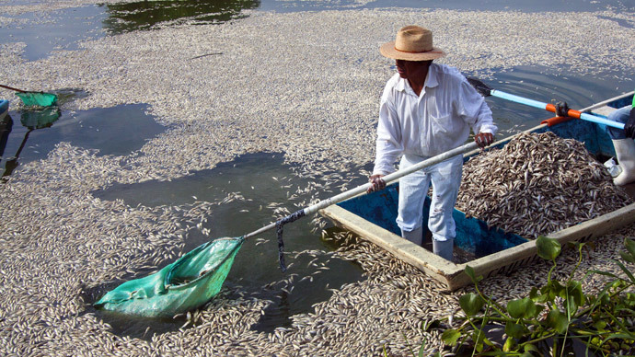

DRON´t pollute our water!
Source: geo-mexico.com

Slide 3
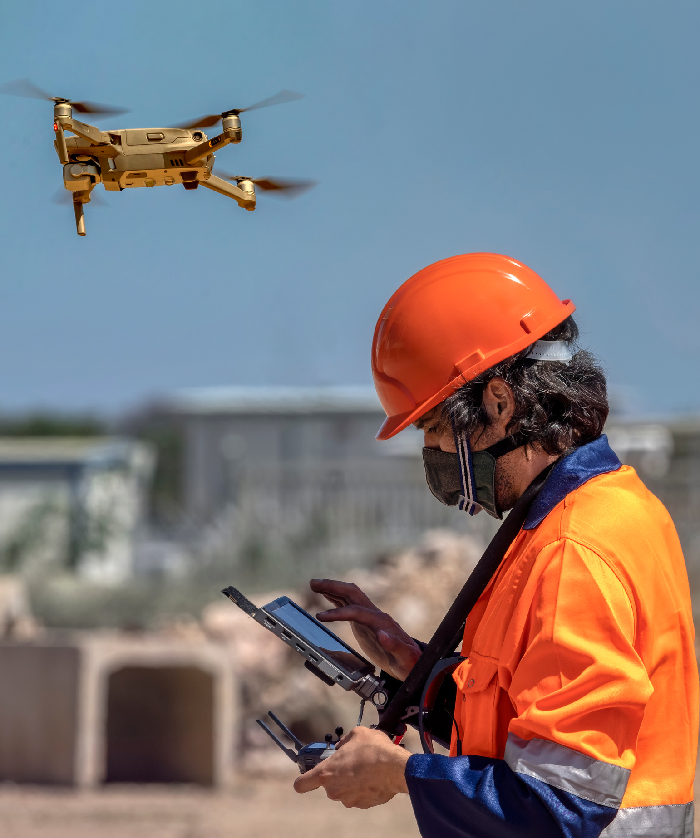
The project AQUABOTICS borns with the idea to help local authorities related to water quality to timely detect unauthorized discharges of polluted water into our most important lakes in Jalisco and other lakes of México.

Slide 4

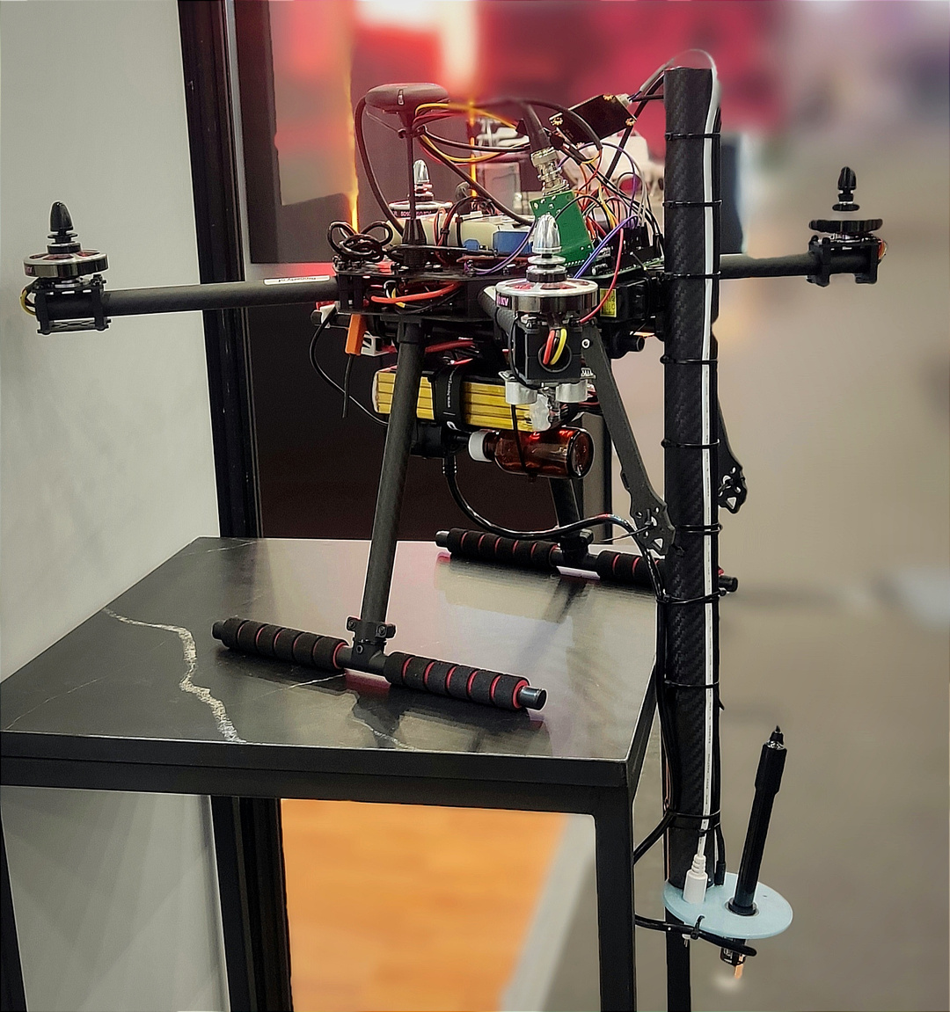

The solution
Our team equipped a middle range drone with different types of water quality sensors that can produce a first approach about the water quality on the measurement zone to timely give an alert to authorities so they can attend the problem as soon as posible.

Slide 5

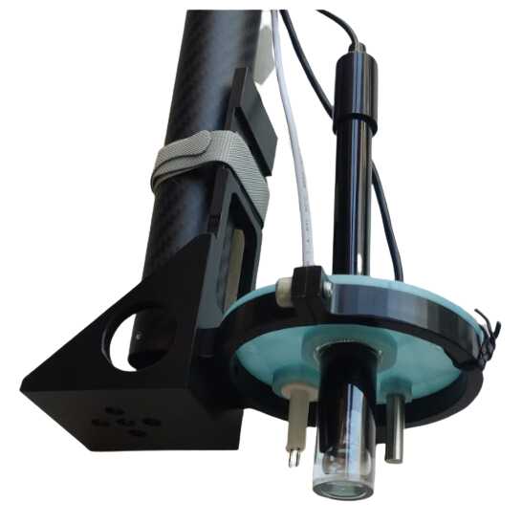
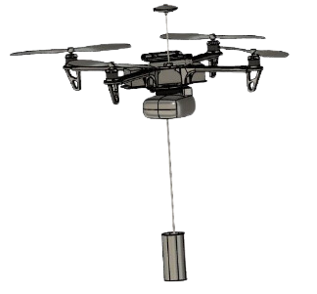

Sensors and deployment

Slide 6
Application
In order to control and have the feedback from the drone and the sensors we develop a control application which can be used to specify the measurement areas and provide the report of all the drone position and sensors readings.

Slide 7

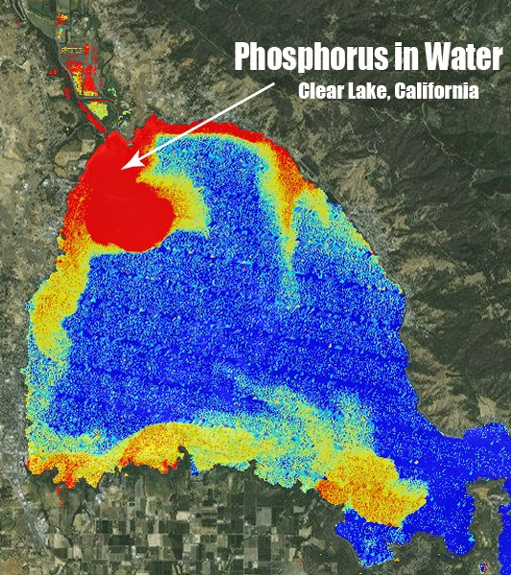
Data
All the data from the drone can be used to:
Timely give alert to authorities.
Fast water quality reports.
Reduce risk of pollution in human consume water.
Analysis of bodies of water for agriculture or other specific purposes.
The sensors, data, and reports can be easily updated for specific use cases from different clients and needs.

Slide 8
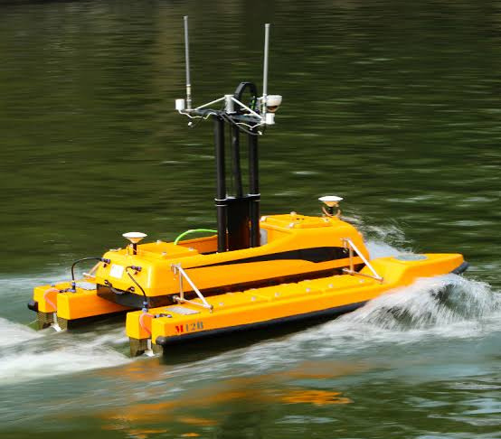
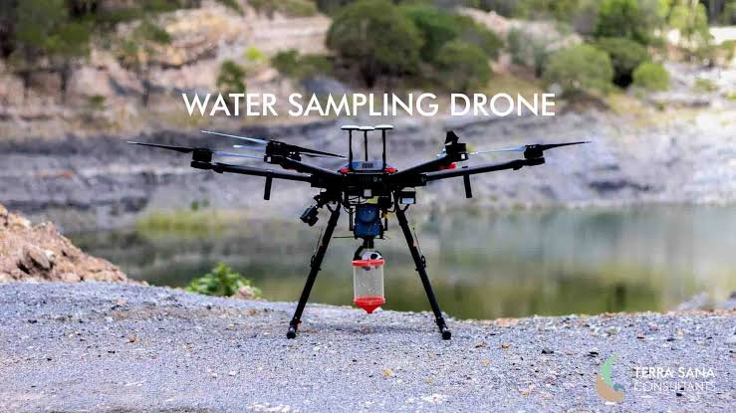
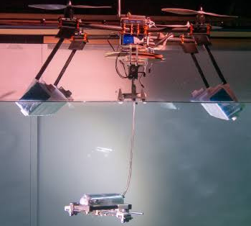
Conclusions
There are many purposes for man kind and technology, stay focus in the ones that will leave a better world!

